Slide 1

Analysis of MFC location
in Seoul
Data Mining Application Team Project
201800302 강대경 201801158 김 찬 201802033 신 용 201904193 김나연

Slide 2
CONTENTS
CHAPTER 01 ㅣ Topic selection background
CHAPTER 02 ㅣ Cluster MFC Demand Areas
CHAPTER 03 ㅣ Prediction of suitable gas station location for MFC entry
CHAPTER 04 ㅣ Results

Slide 3













01. Topic selection background
Benefits of MFC Installation
Existing logistics process
Small Urban distribution center ‘Micro Fulfillment Center’
‘Fulfillment’ refers to a service of all processes of product delivery to customer such as product storage, selection and delivery Existing distribution centers are generally located outside the city
MFCs are located the city and if the product is stored in MFC in advance by predicting consumer preferences
The time between ordering and delivery can be greatly reduced
Order
Storage Center
Logistics Sub terminal
Logistics Hub terminal
Logistics Sub terminal
Customer
‘Fulfillment’ logistics process
Order
Logistics Sub terminal
E-Fulfillment Center
Customer
MFC and Oil station
Judging that ‘Gas station’ and ‘MFC’ features are similar
: Discussion of the need for MFC in the city
Decrease in demand for gas stations
But Where?
: It is difficult to secure a new location in Seoul
Distance from demand
Expected change in oil station
Change the role of oil station
: Anticipation of changes in places
“CJ 대한통운 SK에너지, 주유소를 도심 물류센터로” -조선 비즈-

Slide 4
01. Topic selection background
Procedure
Data collection
Data pre-processing
Analysis (Part 1)
Analysis (Part 2)
Part 1 (Clustering)
Part 2
Classification to determine whether it is the optimal location
Variable setting
Data collection by districts and oil station
Merge the data by common variable
Agglomerative
K-means
K-medoid
GMM
Data reduction by PCA
-Land value
-Gas station address
-Population
-CJ delivery data
-Commercial sales data
-Code information of address
-Commercial sales area
-CJ delivery service monthly data
-Distribution center address
Part 1 (Clustering)
Identify the optimal location candidate using clustering methods
Part 2
Compare the performance to neural networks
Data Scaling
Calculate value using QGIS

Slide 5
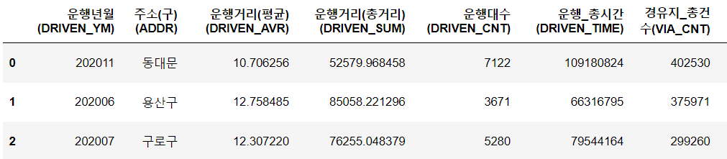
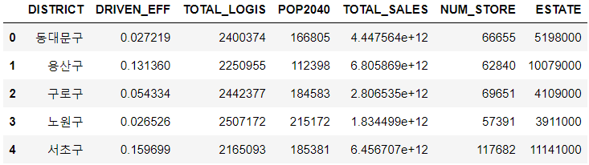

02. Cluster MFC Demand Areas
Pre-processing / EDA / Clustering
Pre-processing
Variables Used for Clustering
Generate derivable attribute : Driving Efficiency
Variable | Contents
DRIVEN_EFF | Operational efficiency; 서울특별시 빅데이터 캠퍼스 > CJ택배 운행량 월별 통계.csv
TOTAL_LOGIS | Delivery volume by region; 서울 열린 데이터 광장 > 주민등록인구.csv
POP2040 | Number of Producible Populations; 서울 열린 데이터 광장 > 주민등록인구.csv
TOTAL_SALES | Off-line commercial sales; 서울 열린 데이터 광장 > 서울시 상권 매출액.csv
NUM_STORE | Size of offline commercial area; 서울 열린 데이터 광장 > 서울시 우리마을가게 상권분석 서비스
ESTATE | Official land price; 서울특별시 빅데이터 캠퍼스 > CJ택배 운행량 월별 통계.csv
Data used to obtain Driving Efficiency
Driving Efficiency = $\left(\frac{Driven_Sum}{Driven_Time}\right)∗\left(\frac{VIA_CNT}{Driven_CNT}\right)$
The following is a preprocessing of collected data for clustering
 | Operation efficiency is proportional to the speed of operation and the number of transit points.
 | Operational efficiency is inversely proportional to the number of operations.
Preprocessed data
“ Areas with high operational efficiency
already have high delivery efficiency “

Slide 6
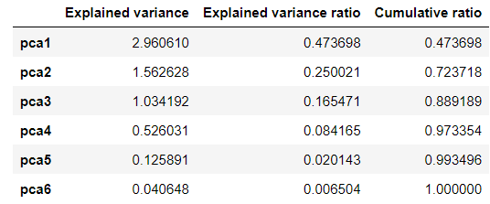
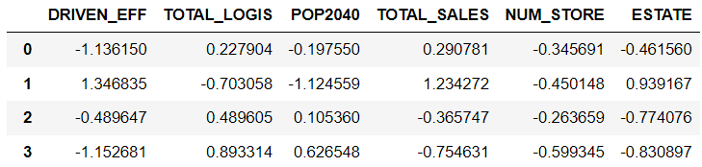
02. Cluster MFC Demand Areas
Pre-processing / EDA / Clustering
Standard Scaling
PCA Analysis
If the data is scaled differently by characteristics, machine learning may not
work well, so data scaling ensures that the range of all characteristics is the same
PCA Analysis : high-dimensional data → low-dimensional data
There is no need to proceed with PCA because the 6 variables are small enough, but we did. Select the number of PCA with a described variance of 0.7 or greater and a cumulative rate of 80% or greater.
Preprocessed data
PCA Analysis Results
Standard Scaling
The variance of PCA 3 is greater than 0.7 and the cumulative rate is greater than 80%.
“ PCA3 is suitable “

Slide 7
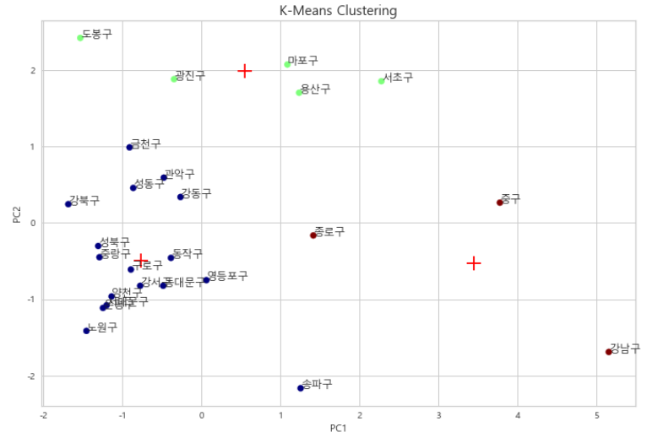
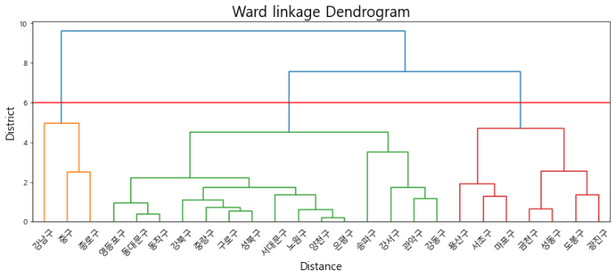
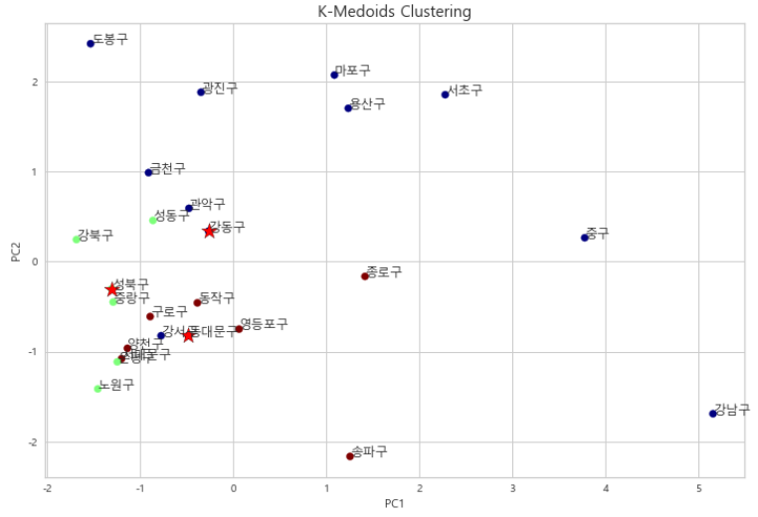
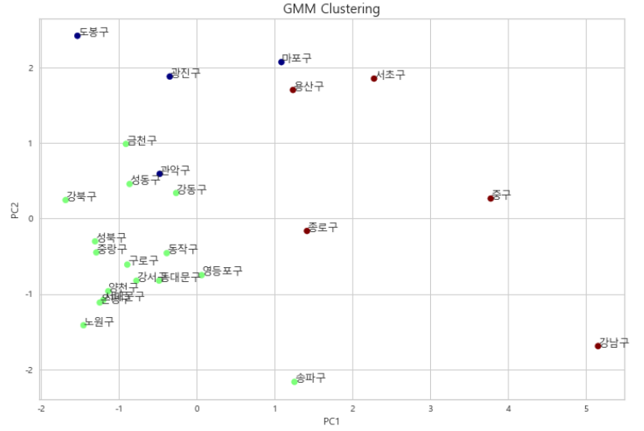
02. Cluster MFC Demand Areas
Pre-processing / EDA / Clustering
Clustering : Using 4 Techniques
Results of each clustering methods and selected districts are suitable for MFC location
1. K-means
3. Agglomerative
Each cluster is marked
as the center of the cluster and must be sensitive
to outliers and specify the number of clusters k.
Cluster results can vary depending on distance measurements and
do not require setting a value for k.
2. K-medoids
4. GMM
Using midpoints instead
of means is less sensitive than k-means clustering,
but it takes a long time because all distances are calculated repeatedly.
Even if the variance is not constant, clustering can be
well generated, but it has computational complexity and good results cannot be expected if it does not fit the Gaussian distribution assumption.

Slide 8
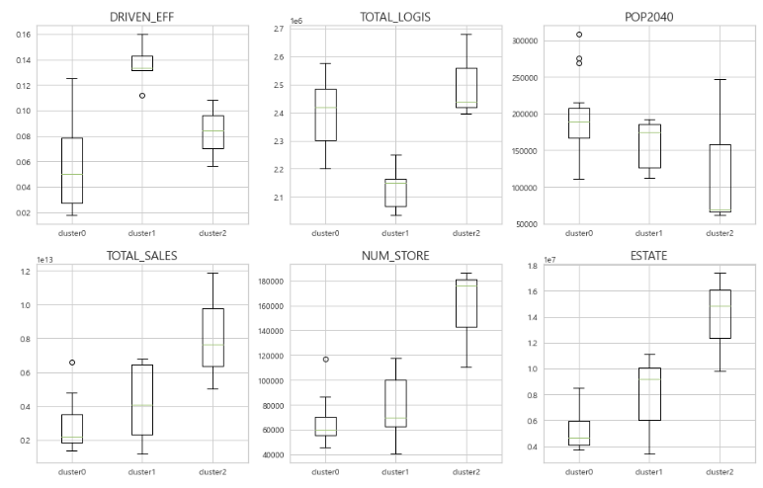
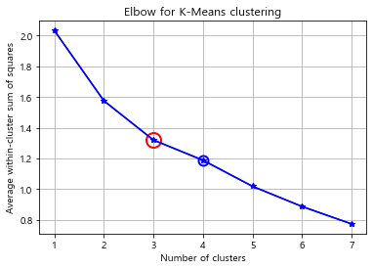

02. Cluster MFC Demand Areas
Pre-processing / EDA / Clustering
K-means
Step 1
Step 2
Choose the number of cluster k
Interpret each cluster and determine suitable or not
① Eblow method
: Use the turning point in the curve of sum of
within cluster variance
② Eblow method
: Decompose data objects into a several levels of
nested partitioning
Cluster 0
Cluster 1
Cluster 2
- The lowest logistics
- Since the driven efficiency is the highest,
the logistics service rate is already high
- The commercial and consumption are
adequate
→ Cluster 1 is not suitable
- The logistics and population are high
- The population is large, but the size of
the commercial is small, so we can expect
untact consumption
- The lowest land estate and driven
efficiency
→ Cluster 0 is suitable
- The highest total logistics
- The highest commercial and
consumption power relative to the
population
- But the highest land estate
→ Cluster 2 is not suitable

Slide 9
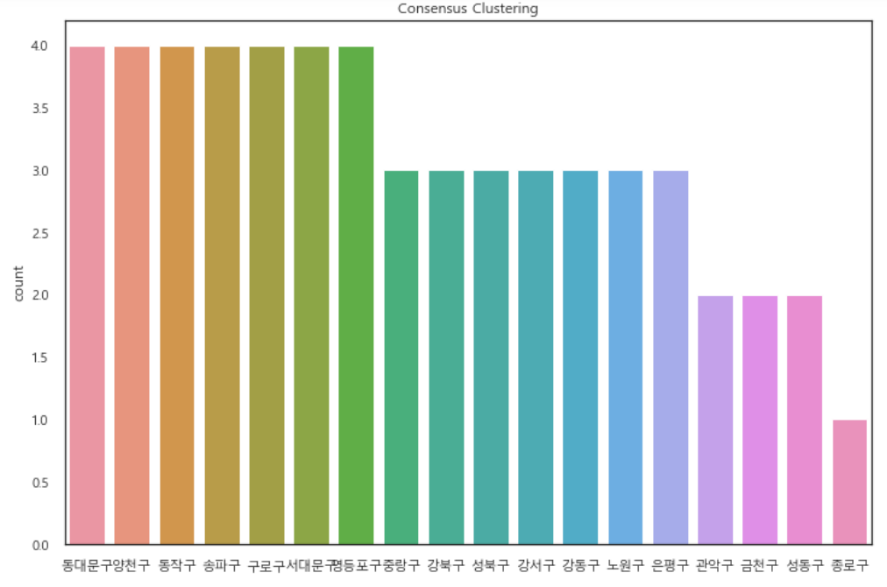
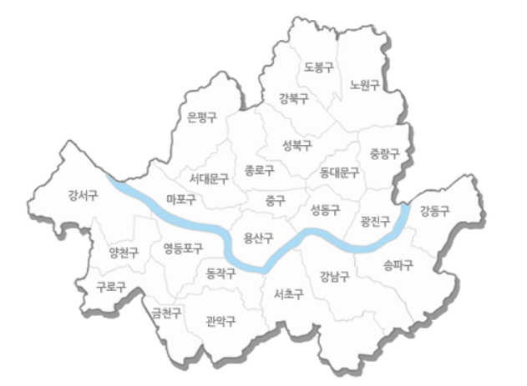
02. Cluster MFC Demand Areas
Pre-processing / EDA / Clustering
Consensus
By combining all four method results , MFC is most needed has been selected
The areas where the final MFC is most needed : 동대문구, 양천구, 동작구, 송파구, 구로구, 서대문구, 영등포구

Slide 10
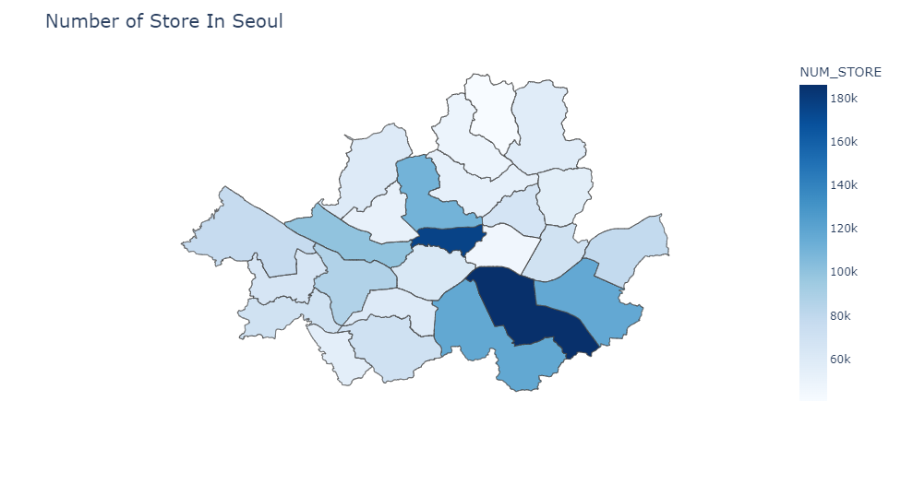
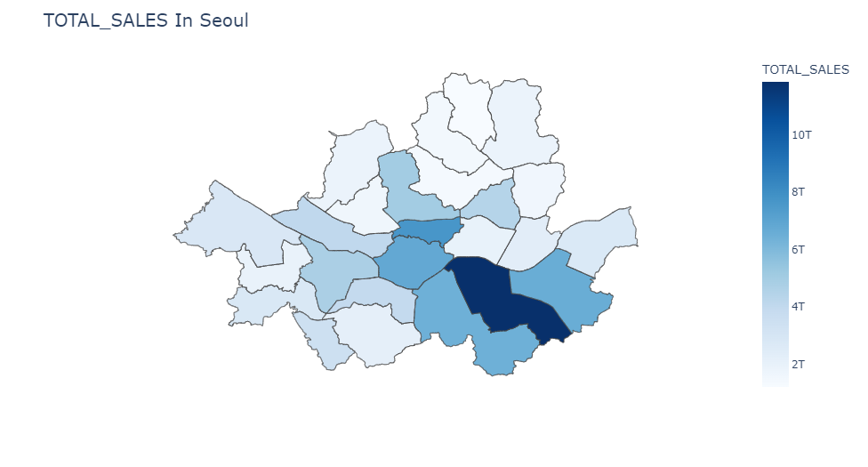
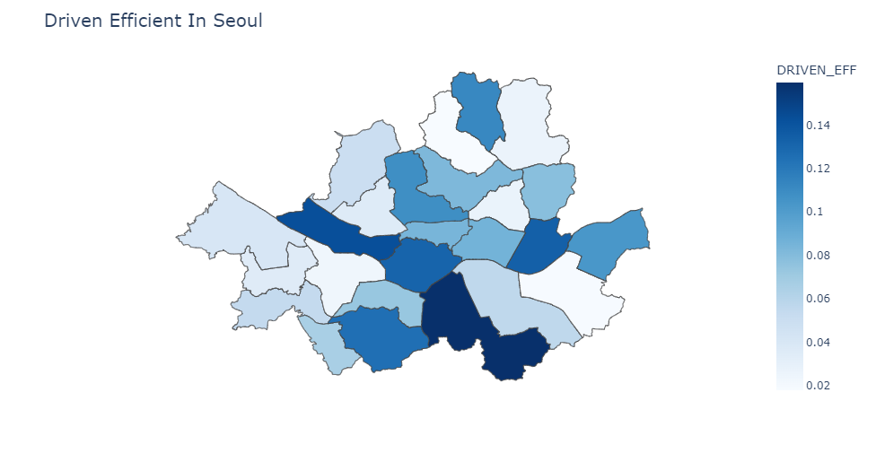
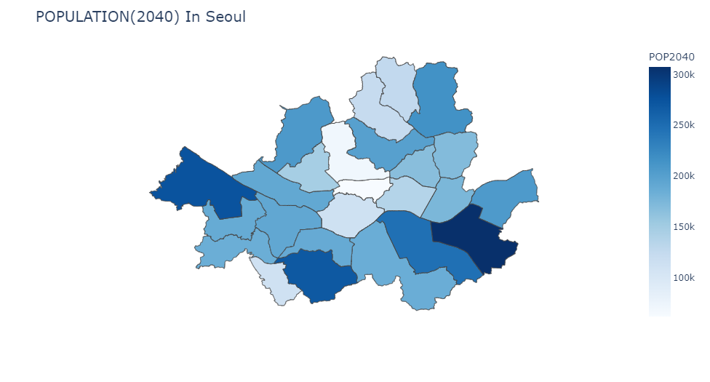
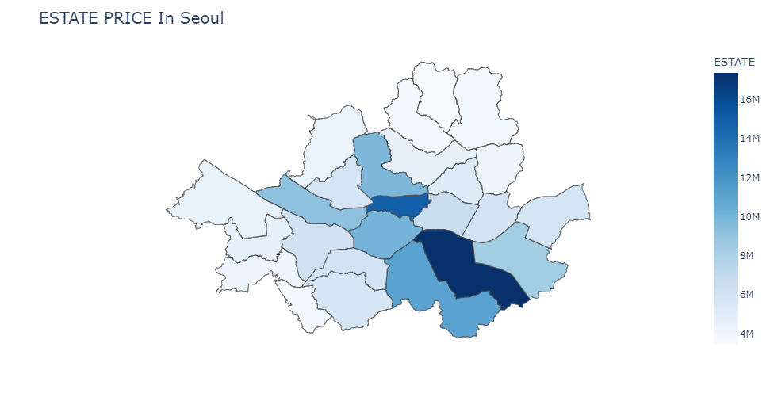
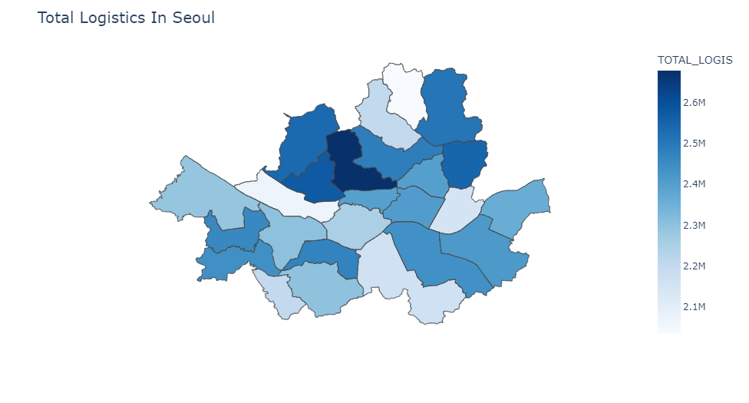
02. Cluster MFC Demand Areas
Pre-processing / Artificial Neural Network / Classification
Pre-processing / EDA / Clustering
EDA
Number of Store In Seoul
TOTAL_SALES In Seoul
Driven Efficient In Seoul
POPULATION(2040) In Seoul
ESTATE PRICE In Seoul
Total Logistics In Seoul

Slide 11
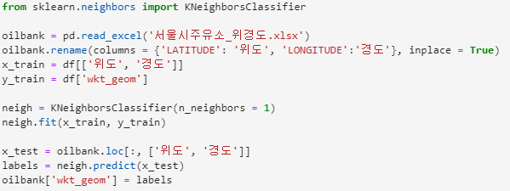
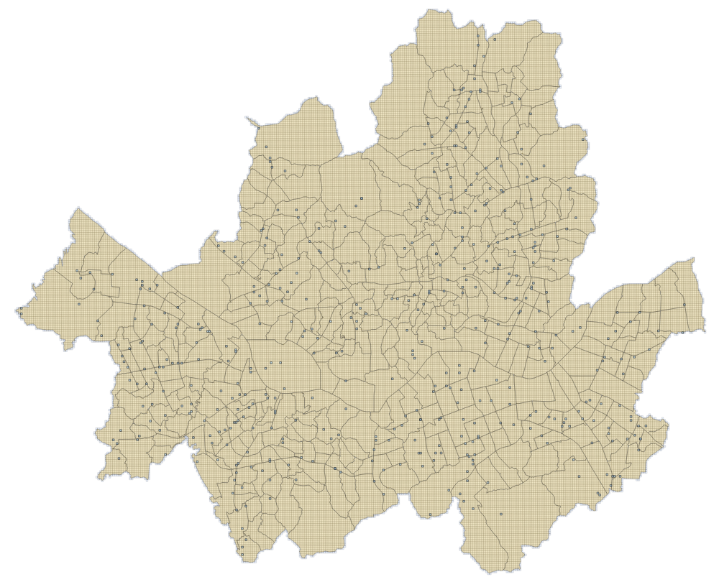
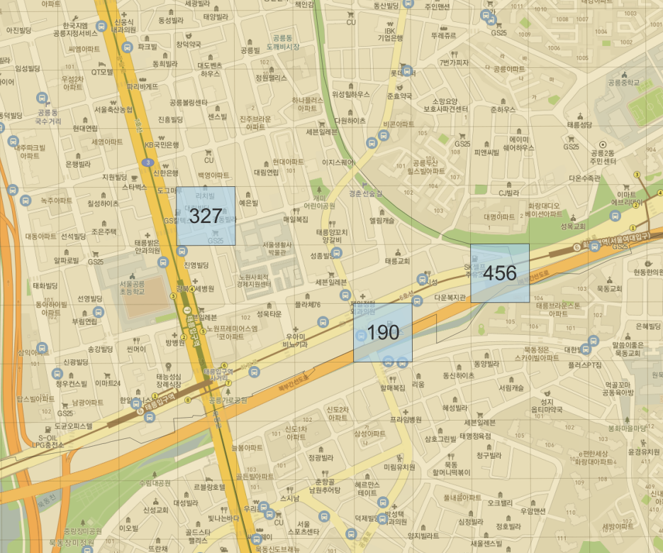
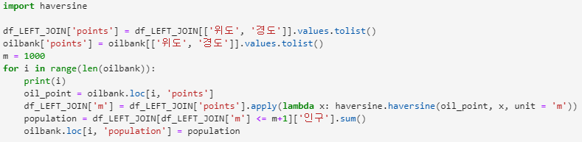
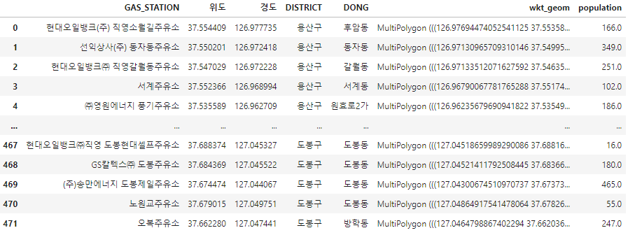
03. Prediction of suitable gas station location for MFC entry
Pre-processing / Classification / Association Rules
Independent variables : Population
Data on the total population (personnel) were obtained from the SGIS statistical geographic information service, and the number of factors within a 1km radius of the gas station was extracted. This extracted data is then converted into a SHP file and visualized in QGIS.
Visualize 1KM Population Count with QGIS
: represents the location of the gas station, and the number in this grid represents the number of people with a radius of 1 KM.

Slide 12
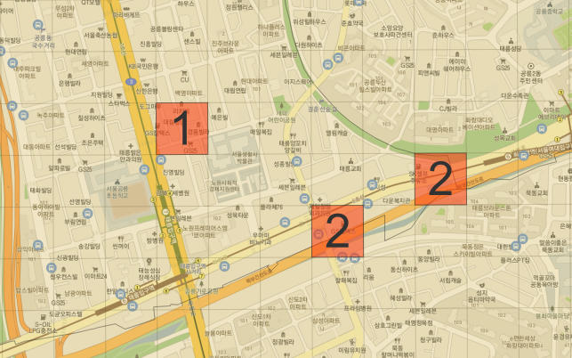
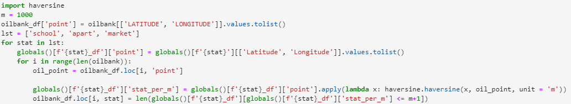
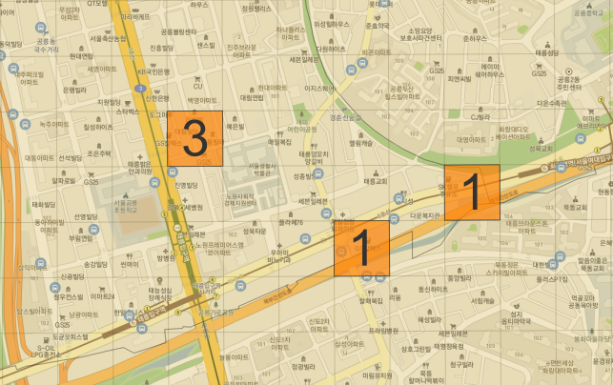
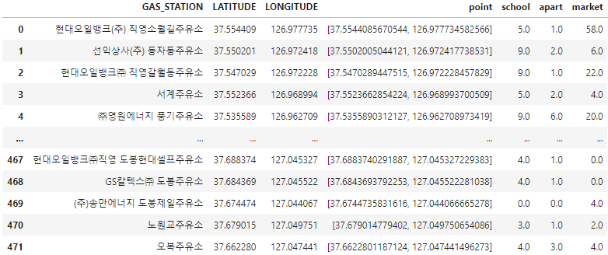
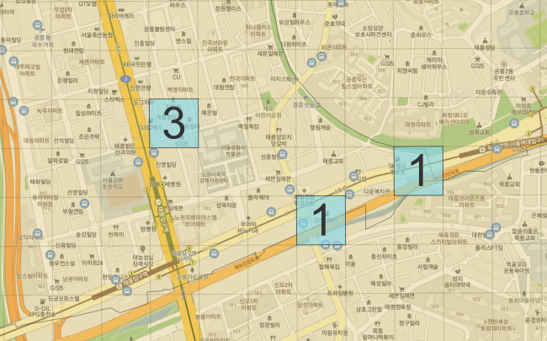
03. Prediction of suitable gas station location for MFC entry
Pre-processing / Classification / Association Rules
Independent variables : School & Apart & Market
The Ministry of Land, Infrastructure and Transport obtained data on the number of schools, apartments, and markets within the range of Seoul, and obtained numbers within a 1KM radius based on each gas station with the data.
Visualize 1KM School & Apart & Market Count with QGIS
One red grid represents the location of one gas station, and the number in this grid represents the number of schools within a radius of 1 KM.
One orange grid represents the location of one gas station, and the number in this grid represents the number of Aparts within a radius of 1 KM.
One blue grid represents the location of one gas station, and the number in this grid represents the number of markets within a radius of 1 KM.

Slide 13
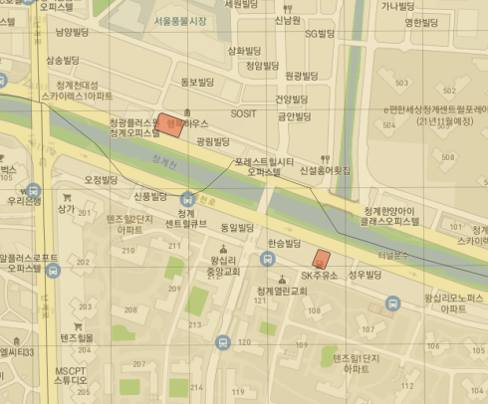
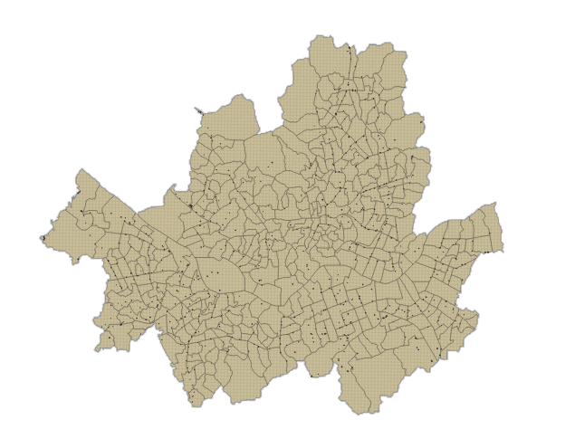
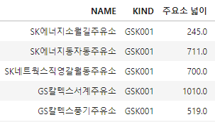


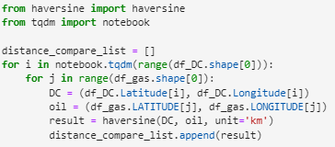
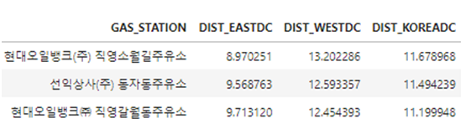
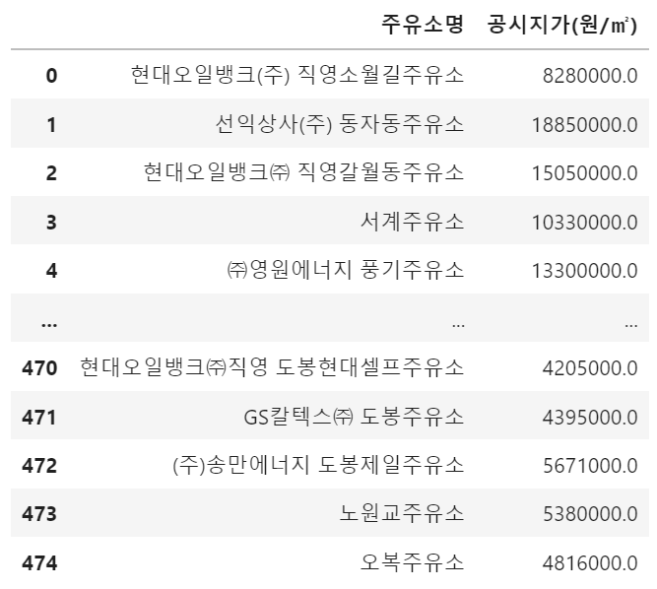
03. Prediction of suitable gas station location for MFC entry
Pre-processing / Classification / Association Rules
Independent variables : Area & Land price
Independent variables : Coverable distance
Use the '$AREA' function of the QGIS program to find the area of each gas station in the polygon form of the gas station shp file.
The distance to each terminal was calculated based on each gas station.
Variable | Definition
dist_eastDC | the streets from the east to the terminal
dist_westDC | the streets from west to terminal
dist_koreaDC | Streets to Korea Terminal
q
SHP files at the gas station
WEST
TERMINAL
②
①
EAST
TERMINAL
GAS
STATION
KOREA
TERMINAL
① dist_eastDC
② dist_westDC
③ dist_kroeaDC
③
The individual publicly announced land price at gas stations was selected as an independent variable because it was related to rent incurred when entering MFC.

Slide 14
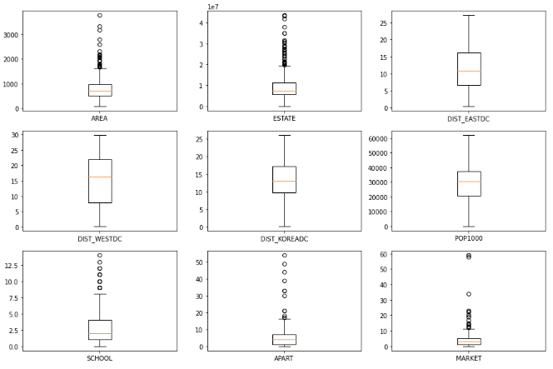
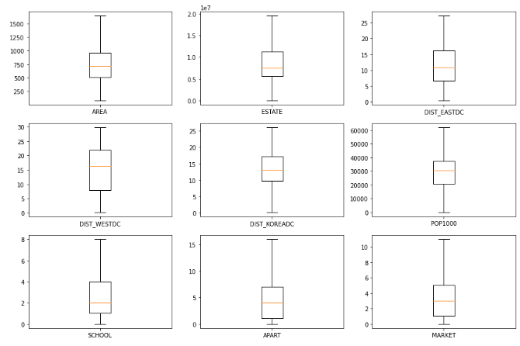
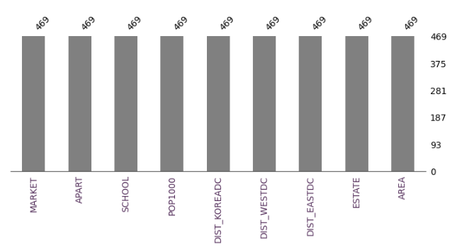
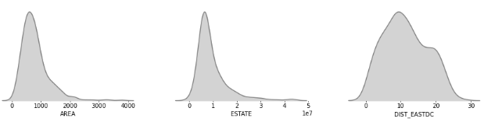
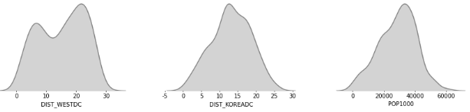
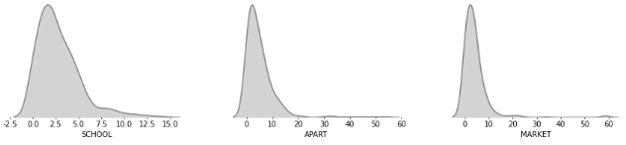
03. Prediction of suitable gas station location for MFC entry
Pre-processing / Classification / Association Rules
EDA
The following graph shows that not all values of the independent variable are null values.
Although there is no missing value, outliers exist for each variable, so outliers were removed.
Visualize that data has no null value
Rather than removing the abnormal value, the lower limit (25%) and the upper limit (75%) were determined, and if it is less than the lower limit, it was replaced with a lower limit value, and if it is greater than the upper limit, it was replaced with an upper limit value.
Numeric Features Distribution

Slide 15
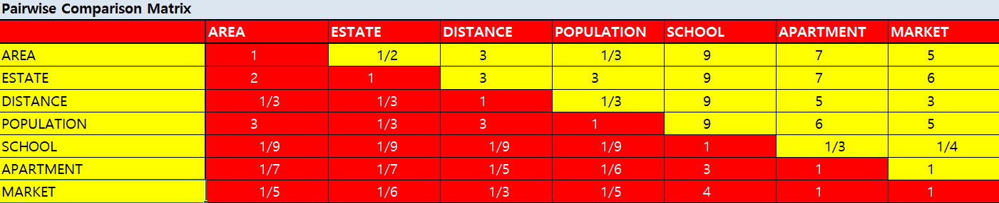
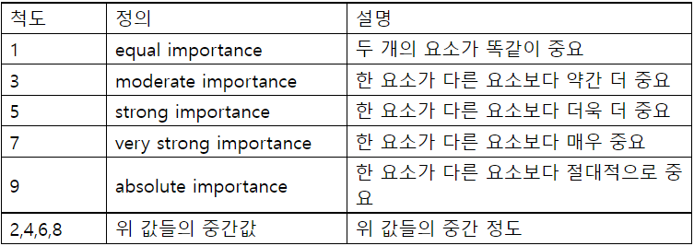
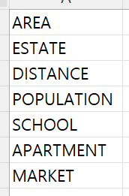
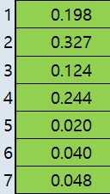
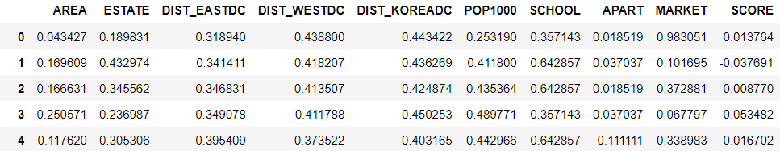
03. Prediction of suitable gas station location for MFC entry
Pre-processing / Classification / Association Rules
Set Dependent variable : Using AHP method
Using the AHP(Analytic Hierarchy Process) to calculate the weights of the independent variables of the location score function
$SCORE=\left(AREA ∗0.198\right)−(ESTATE ∗0.327)$ - $(DIST_EASTDC ∗0.0413)$ - $(DIST_WESTDC ∗0.0413)$ - $(DIST_KOREADC ∗0.0413)$ +$(POP1000 ∗0.244)$ +$(SCHOOL ∗0.020)$ + $\left(APART ∗0.040\right)+MARKET ∗0.048)$
After minmax scaling and calculate location score

Slide 16
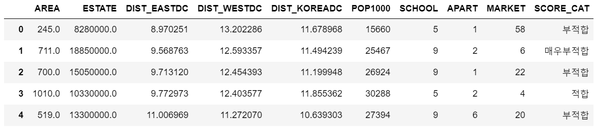




03. Prediction of suitable gas station location for MFC entry
Pre-processing / Classification / Association Rules
Multi-class Classification
SCORE | Category
(-0.296, -0.00108] | 매우 부적합 (Most Unsuitable)
(-0.00108, 0.0432] | 부적합 (Unsuitable)
(0.0432, 0.0825] | 적합 (Suitable)
(0.0825, 0.184] | 매우 적합 (Most Suitable)
Using qcut(), Generate categorical variable “SCORE_CAT”
Training Set
Modeling
Decision Tree
Logistic Regression
K-Nearest Neighbor
Random Forest
Gradient Boosting Classifier
Dataset
Test Set
Precision
Evaluation
Accuracy, Precision, Recall, …

Slide 17

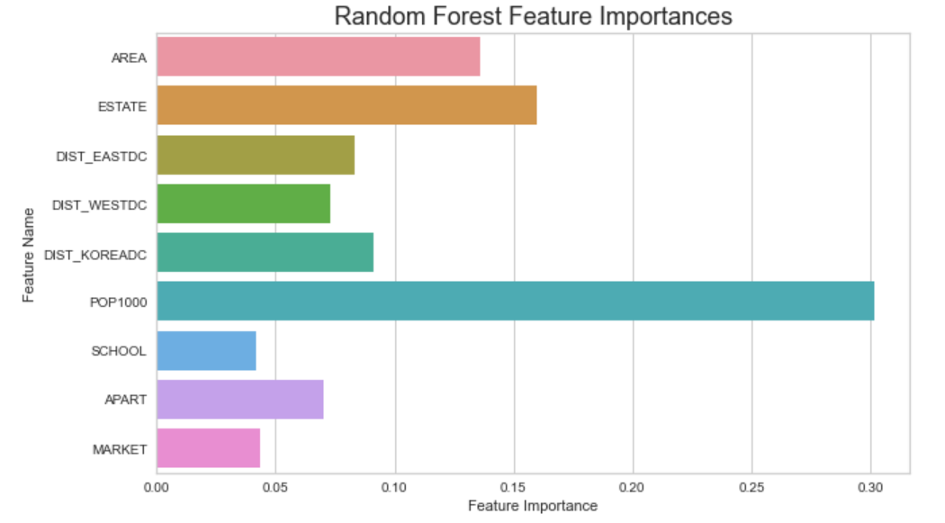
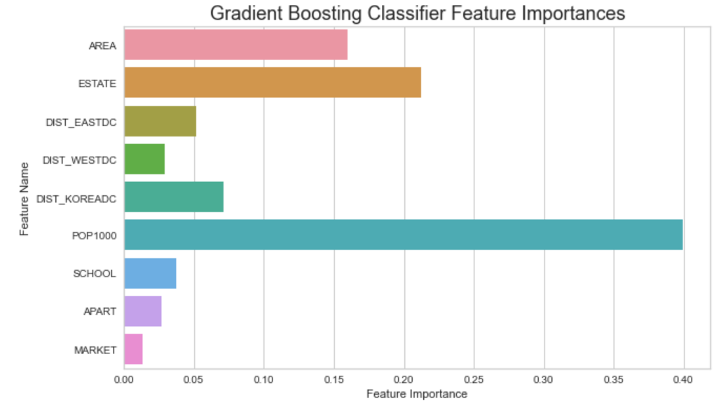
03. Prediction of suitable gas station location for MFC entry
Pre-processing / Classification / Association Rules
Multi-class Classification
Model Evaluation
Model Evaluation
Model |  | Precision | Recall | F-1 Score | Accuracy
Random Forest | Most Unsuitable | 0.86 | 0.82 | 0.84 | 0.7589
 | Unsuitable | 0.61 | 0.63 | 0.62
 | Suitable | 0.69 | 0.65 | 0.67
 | Most Suitable | 0.82 | 0.89 | 0.85
Gradient Boosting Classifier | Most Unsuitable | 0.88 | 0.84 | 0.86 | 0.766
 | Unsuitable | 0.59 | 0.63 | 0.61
 | Suitable | 0.67 | 0.71 | 0.69
 | Most Suitable | 0.88 | 0.83 | 0.85
Model | Accuracy
DT | 0.7518
LR | 0.6667
KNN | 0.6667
RF | 0.7589
GBC | 0.766
“Population” is the most important feature in RF & GBC.

Slide 18
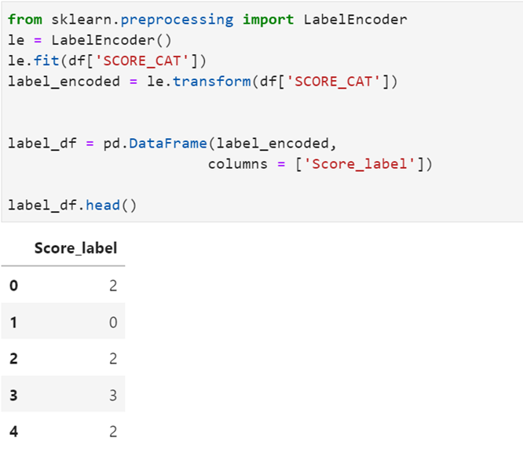
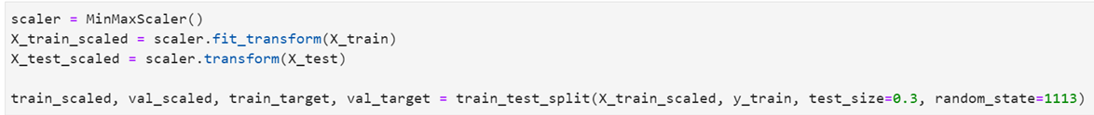


03. Prediction of suitable gas station location for MFC entry
Pre-processing / Classification / Association Rules
Pre-processing / Artificial Neural Network / Classification
Multi-Class-Neural Network : 4 Steps
The method is a technique for constructing a model needed to recognize unique patterns or structures in the data and proceeds to four steps.
1. Label Encoding for Multi-classification ANN
2. Data processed
- 매우부적합(Most unsuitable) : 0
- 부적합(Unsuitable) : 2
- 적합(Suitable) : 3
- 매우적합(most Suitable) : 1
Train-test
data split
Data scaling
Validation
2. Define the Neural Network Model
4. Fit model
- 9 Indep. Variables -> input shape : 9
- 4 Dep. Variables -> Last Layer: 4
- Multi class -> Activation f(x) : Softmax
- Most popular optimizer -> ‘Adam’
- Loss & Metrics -> ‘Sparse_categorical’

Slide 19

03. Prediction of suitable gas station location for MFC entry
Pre-processing / Classification / Association Rules
Pre-processing / Artificial Neural Network / Classification
Multi-Class-Neural Network : Evaluation
After completing the 4 steps of the 'Multi-Class-Natural Network’,
the training and verification loss rate and training and verification accuracy were evaluated.
Train & Valid Loss (훈련 및 검증 손실률)
Train & Valid Accuracy (훈련 및 검증 정확도)
Result
FINAL LOSS : 0.139630 FINAL ACCURACY : 0.957447
As a result of checking the loss rate and accuracy,
it can be confirmed that a high performance of 95% was achieved without overfitting.

Slide 20





03. Prediction of suitable gas station location for MFC entry
Pre-processing / Classification / Association Rules
Pre-processing / Artificial Neural Network / Classification
Association Rule
Showing how often events happen together and how much they are related to each other.
Use Binning
Use binning to convert numeric variables into categorical variables, which are divided into binary variables greater than or less than the mean.
“ Data when AREA is above 805.6831 on average “
The result of the change between "Minsup" and "Minconf"
Minsup = 10%, Minconf = 75%
Minsup = 10%, Minconf = 65%
Minsup = 20%, Minconf = 40%

Slide 21

03. Prediction of suitable gas station location for MFC entry
Pre-processing / Classification / Association Rules
Pre-processing / Artificial Neural Network / Classification
Result
The following is a graph comparing the accuracy of the algorithm.

Slide 22
03. Prediction of suitable gas station location for MFC entry
Pre-processing / Classification / Association Rules
Pre-processing / Artificial Neural Network / Classification
Expectation effectiveness
SEOUL
There is a possibility that the introduction of MFC in Seoul on a trial basis will cause innovation in the logistics industry
→Recession caused by COVID-19, can revitalize the economy
CUSTOMER
As the logistics delivery process decreases, various products can be received faster than now
GAS STATION
Even those who have difficulty building their own fulfillment into the city at a low cost
Can increase the competitiveness in the market
LOGISTICS COMPANY
Provides high delivery service at low cost while gaining advantage in the delivery market
Limitation
[1] Logistics data is only available by district, so logistics variables are not considered in the classification model
[2] Considering only the internal conditions of Seoul when analyzing the location
[3] There may be other meaningful variables that we did not think
[4] We don't use MCLP, so we can't find the best place in one place
[5] Our project can’t consider coverage

Slide 23








김나연 : Data-collection, Data-preprocessing using Qgis, EDA for classification, presentation material
강대경 : Data-collection, Data-preprocessing, Association, presentation material
신용 : Data-collection, Data-preprocessing, Clustering, Classification, EDA for clustering, Appendix
김찬 : Data-collection, Data-preprocessing, EDA for clustering, ANN, PT, Final report

Slide 24




Q & A
Thank you for watching!

